Slide 1
Centralized Blood Donation Database System
By Group number 01
Aditya Apte
Srishti Bhandari
Pranali Bhosale

Slide 2
Objectives
Centralized system that consists of all the donor data. This will be accessible by any hospital/blood bank across the country.
Determining when and where to organize a blood donation drive based on the set threshold (a pre-decided minimum available blood in a particular city/town at any given time). This will help in avoiding shortage of blood at any given time.
Easily contact a donor- Thank them for donating or to notify about future blood donation campaign. Also, in-case of emergency request to donate again.
An accurate database will help identify donor rich localities to organize future drives.

Slide 3
Summary of the Design
This Centralized Blood Bank Management System has total 14 entities.
The Supertype entity ‘Person’ has 4 subtype entities – ‘Donor’, ‘Recipient’, ‘Donation Campaign Manager’ and ‘Doctor’.
There are 3 associative entities – ‘Campaign_Blood Bank’, ‘Blood Bank_Hospital’ and ‘Donor_Campaign’.
For security the private information of both Donor’s and Recipient’s is stored in a separate entity called ‘Confidential Details’.
To avoid data redundancy a separate ‘Location’ entity has been created which is linked to other entities such as ‘Hospital’, ‘Campaign’ and ‘Blood Bank’ with the foreign key ‘Pincode’. This entity stores the address information.
The ‘Insurance’ entity stores the insurance details of recipients.

Slide 4
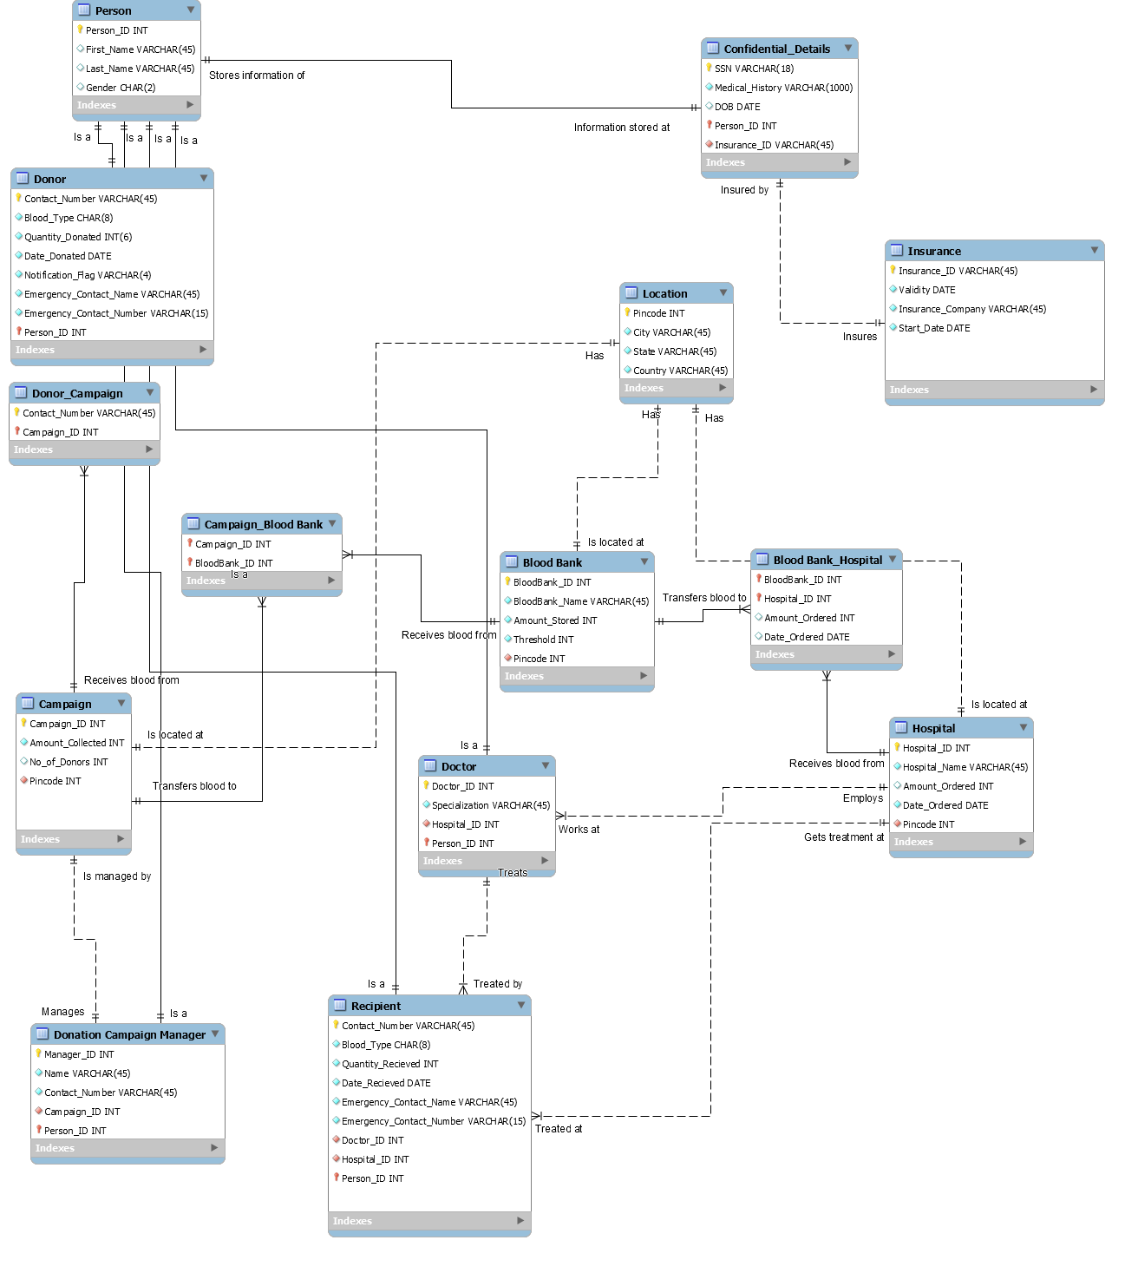
Entity-Relationship Diagram

Slide 5
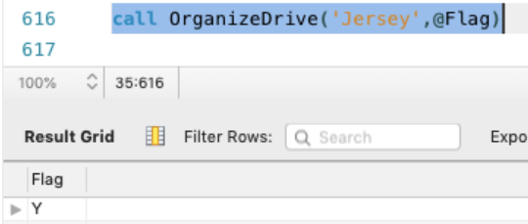
Organizing a Blood Donation Drive
Procedure to see if we should organize a blood donation drive.
If the amount stored is less than the threshold, the procedure will return a Y flag indicating that we should organize a drive.
If it returns a N flag it indicates that there is no need to organize a drive at that moment.
Input parameter: City
Output parameter: Flag
Tables referred: Blood Bank, Location

Slide 6
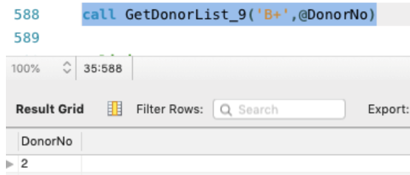
Displaying Number of Donors with a Particular Blood Type
This procedure returns the number of donors for a specific blood type. Here, we input the blood type.
Input parameter: Blood_Type
Output parameter: Count(*) FROM Donor
Input parameter: Blood Type
Output parameter: Number of Donors
Tables referred: Donor

Slide 7
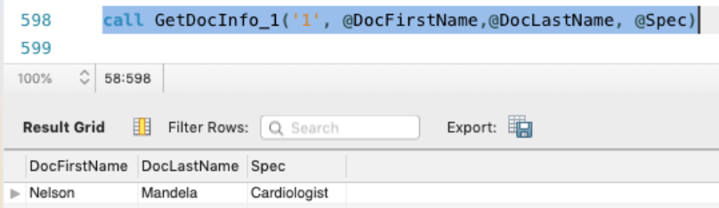
Find the Doctor and his Specialization
Input parameter: d.Hospital_ID
Output parameters: p.First_Name, p.Last_Name, d.Specialization
Tables referred: Person, Doctor
This procedure returns the first and last name of the doctor and his/her respective specialization by entering the hospital’s ID

Slide 8
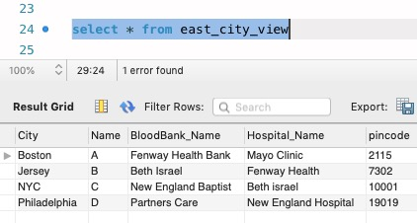

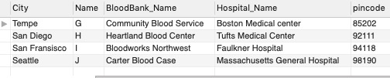
Three Regional Views of Blood Bank Info in the US
This view gives us the City, Campaign Name, Blood Bank Name, Hospital Name and Pincode for all Eastern Cities of US
This view gives us the City, Campaign Name, Blood Bank Name, Hospital Name and Pincode for all Central Cities of US
This view gives us the City, Campaign Name, Blood Bank Name, Hospital Name and Pincode for all Western Cities of US

Slide 9
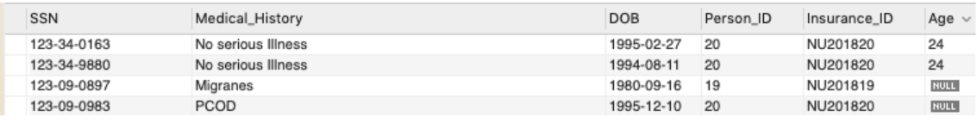
Getting a Person’s Age from his DOB
This is a trigger to get a person’s age when we input his/her DOB. This is an automated calculation.
When a new row is inserted into the ‘Confidential_Details’ table, this trigger will calculate the age of the person using the current date and the DOB entered.

Slide 10

Calculating the Validity of an Individual’s Insurance Policy
This is a trigger to get validity of the person’s insurance policy based on the Start_Date of the insurance. This is an automated calculation.
When a new row is inserted into the Insurance table this trigger calculates the Validity of that insurance using the current date and the start date of particular insurance.

Slide 11
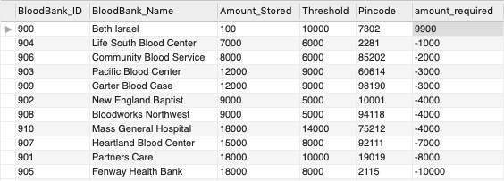
Columns based on Functions
A new column called ‘amount_required’ is created which displays the amount of blood needed by the particular Blood Bank.
To create this column we subtracted the Amount stored at the Blood Bank from it’s Threshold

Slide 12
Additional Objects
Non-Clustered Index
The non-clustered index is created to improve the performance of frequently used queries not covered by clustered index.
CREATE INDEX IX_ID_Flag ON Donor(Notification_Flag, Person_ID);
We have created a non-clustered index on the Donor table to get easier access to donor’s preference on being contacted for promotions.
Table-level CHECK constraints
ALTER TABLE donor
ADD CHECK (Blood_Type IN (‘A+’,'B+','AB+',‘AB-‘,‘A-‘,‘B-‘,‘O+’)); The first constraint makes sure that no invalid blood type is entered into the database.
ALTER TABLE person
ADD CHECK (Gender IN (‘F’,'M’));
The second constraint makes sure that the appropriate gender’s are entered

Slide 13
Thank You.

